Slide 1
D E P A R T M E N T O F C O M P U T E R S C I E N C E U N I V E R S I T Y O F C O P E N H A G E N
Corners and Interest Points Matching
François Lauze
Notes:
1
Forelæsning: 25 personer

Slide 2
Today
Corners – statistical analysis of gradient directions
Harris, Plessey mf.
Interest points matching
Introduction to descriptors

Slide 3
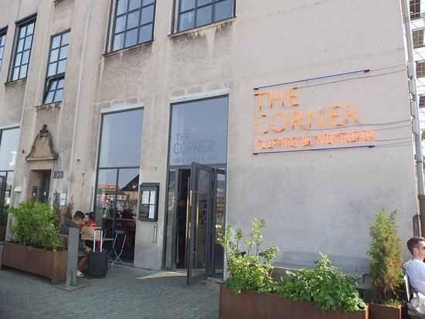
Corners and Edges
There exist a number of approaches to corner detecting. Here we will focus on a single type based on analyzing the statistics of gradients.
a corner
an edge

Slide 4
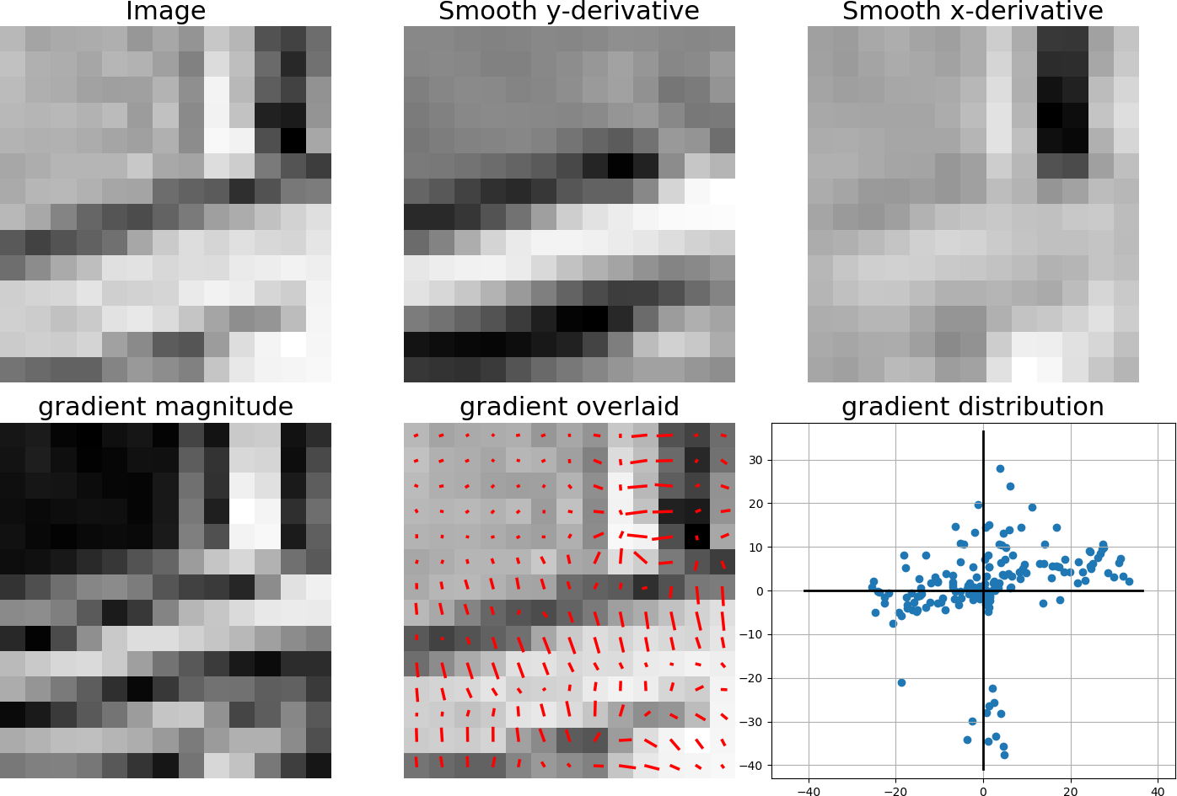
Gradient Distribution of Corners
two main directions

Slide 5
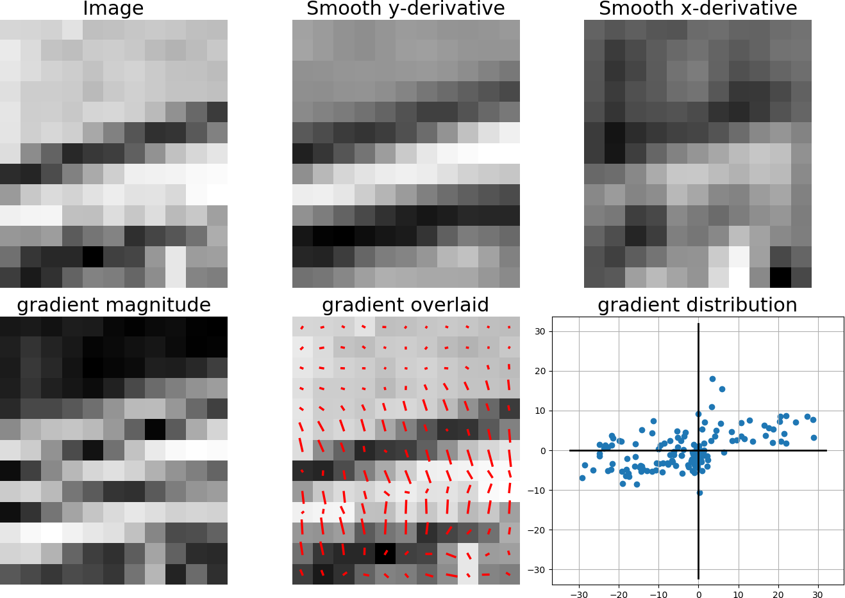
Gradient Distribution of Edges
one main direction

Slide 6
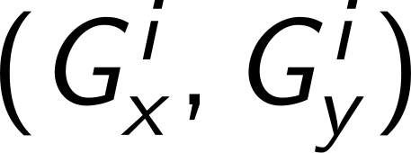
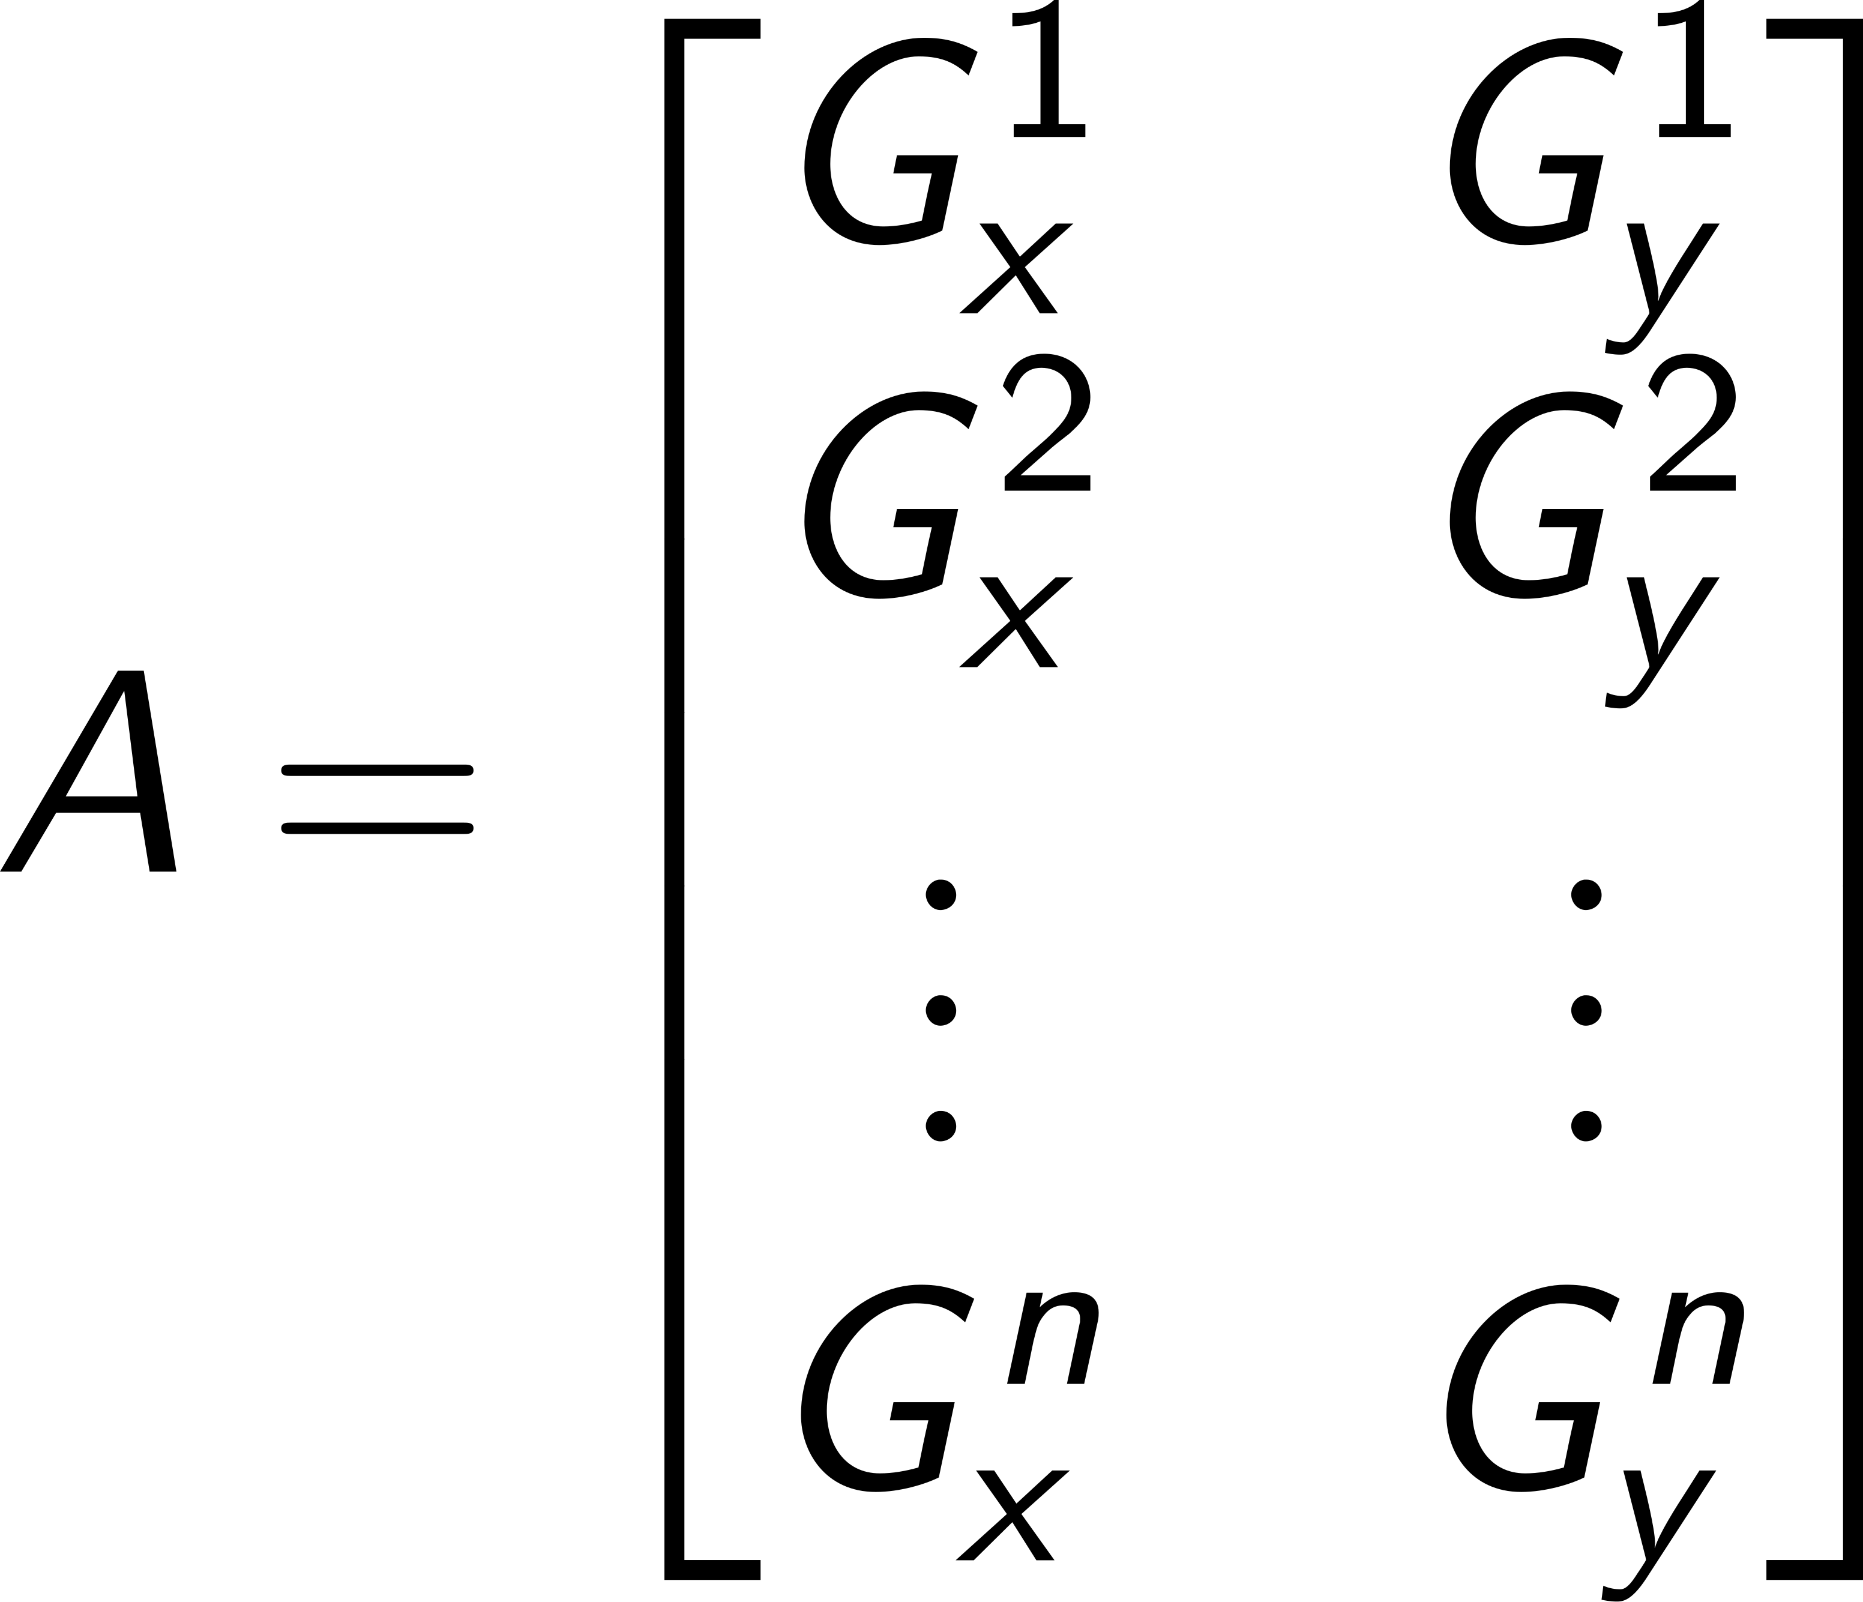
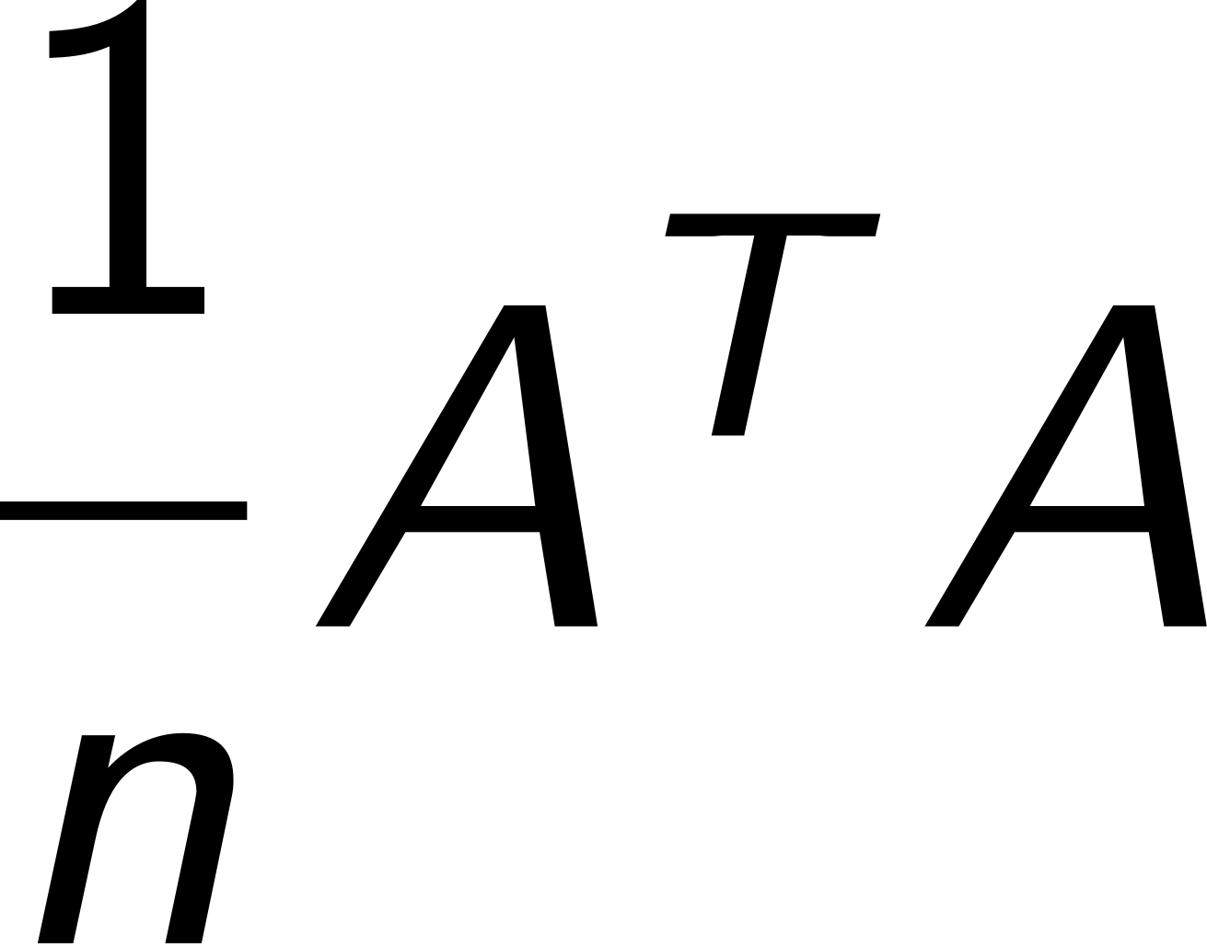
The structure tensor
Let be the i’th gradient in a square area around a potential corner point. In practice each gradient is weighted by a Gaussian of the distance to the point.
Let A_{[Nx2]} be the stack of all N gradients
Let T = be the structure tensor, i.e. a 2x2 symmetric matrix of
sums of products of gradient components.
T captures the second order statistics (i.e. variances and covariance's) of the uncentered gradient point cloud.

Slide 7
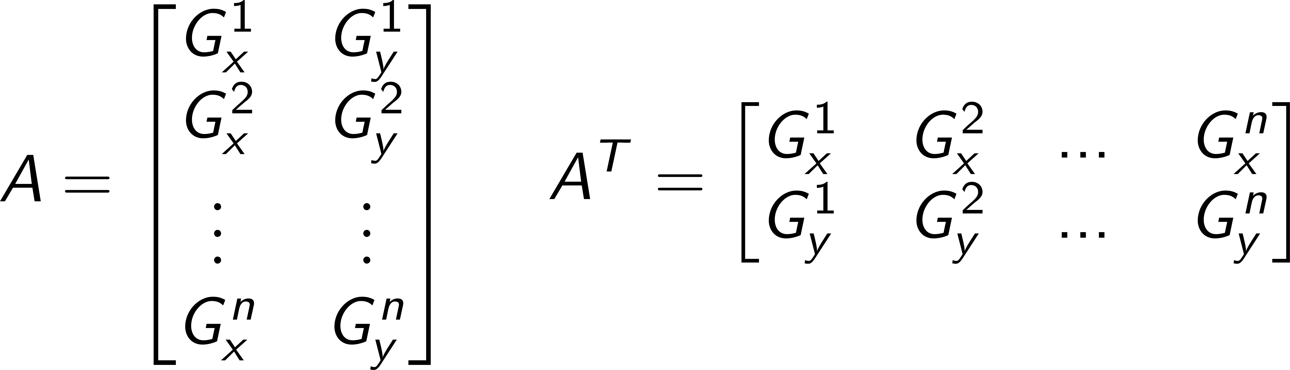
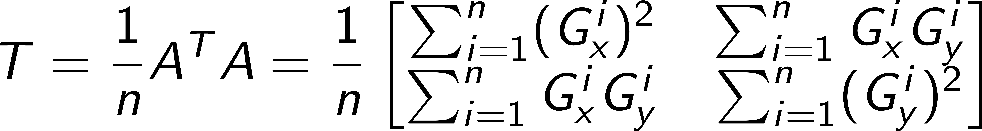
Structure tensor computations
T is a symmetric matrix!

Slide 8
Structure tensor analysis
The first eigenvector of T points in the direction where the gradient point cloud is broadest (has the largest variance given by the first eigenvalue).
The second eigenvector is orthogonal to the first and points in the direction where the gradient point cloud is most condensed (has smallest variance = the 2. eigenvalue).

Slide 9
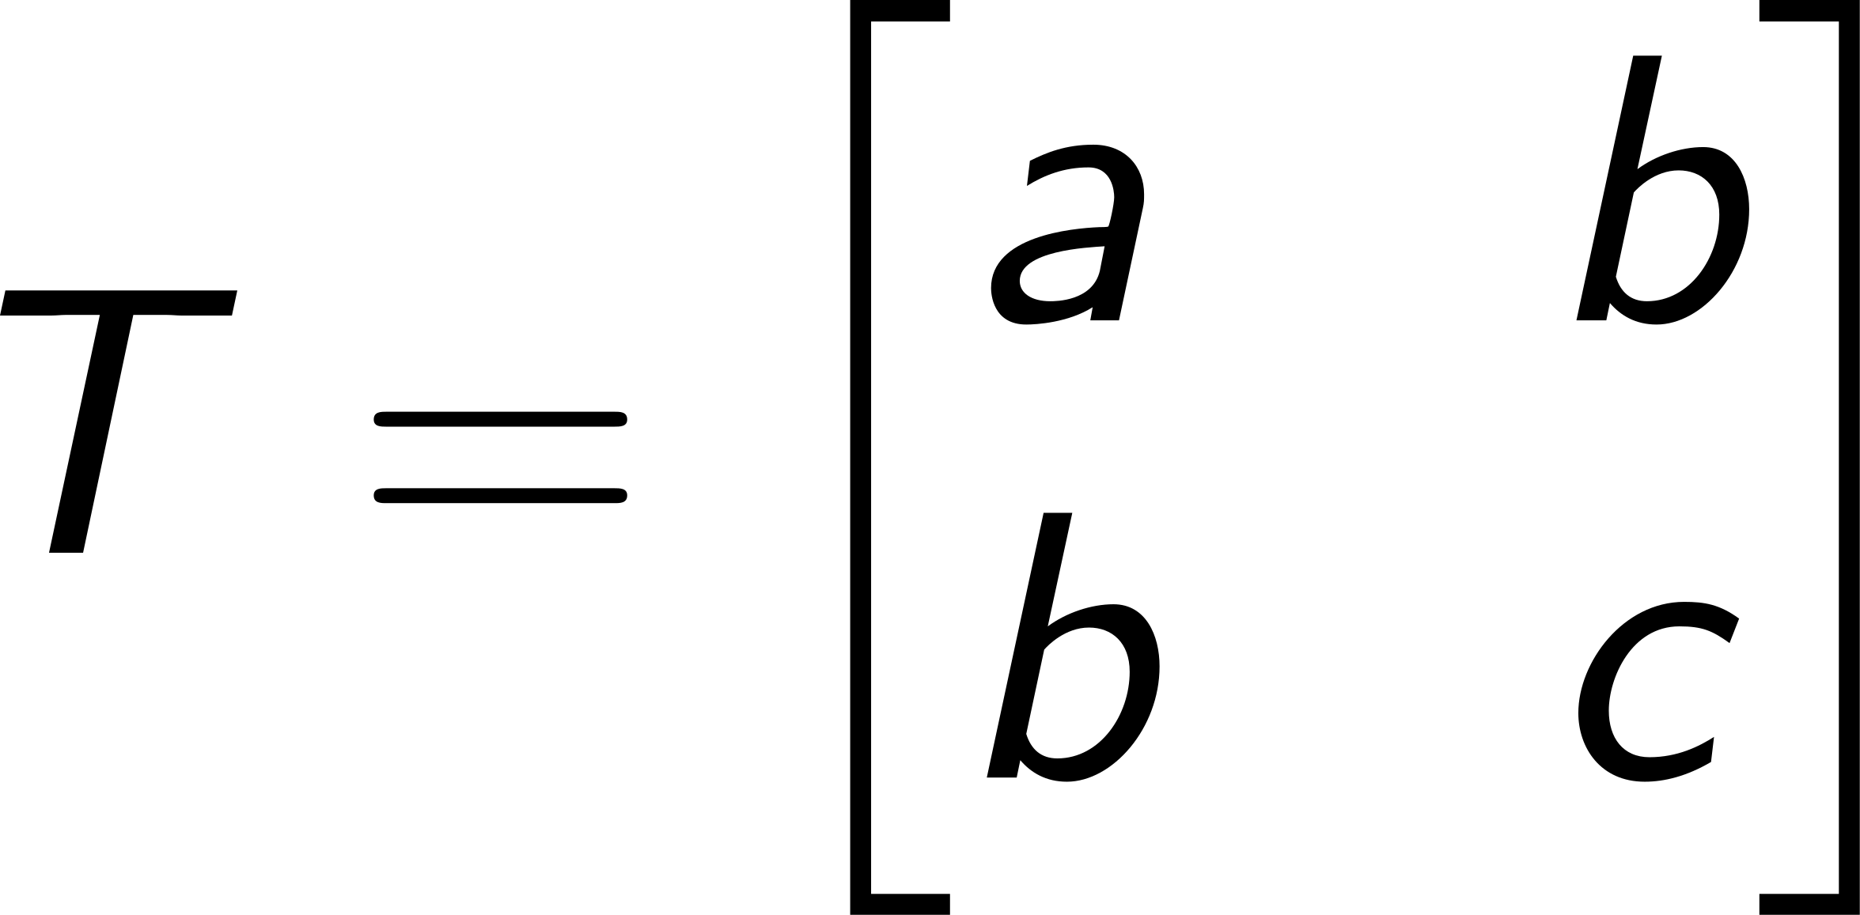
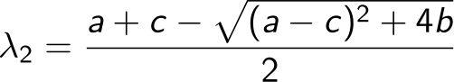
Corners by maximum of smallest eigenvalues
Only if the smallest eigenvalue is large the local gradient points in several dominant directions.
With ,
To verify this solve Tx = x or det(T- I₂) = 0.
Please note that we have to take a square root

Slide 10
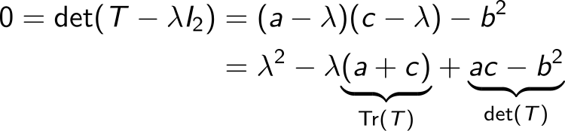
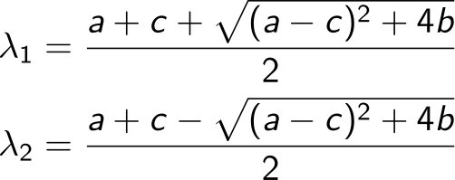
Eigenvalues
The roots are the eigenvalues of T

Slide 11
Eigenvectors
They are the vectors x for which Tx = λx, with λ one of the eigenvalues i.e. one of the λ₁ or λ₂ from previous slide.
There are infinitely many solutions!
If λ₁ ≠ λ₂, there is one vector line of solution per eigenvalue, i.e. two eigenvectors for the same eigenvalue are multiple of each others. So we can choose an eigenvector with norm 1. Still there are two choices: x or -x
This is what Python or Matlab returns when asked to compute eigenvectors (x or -x just by chance).

Slide 12
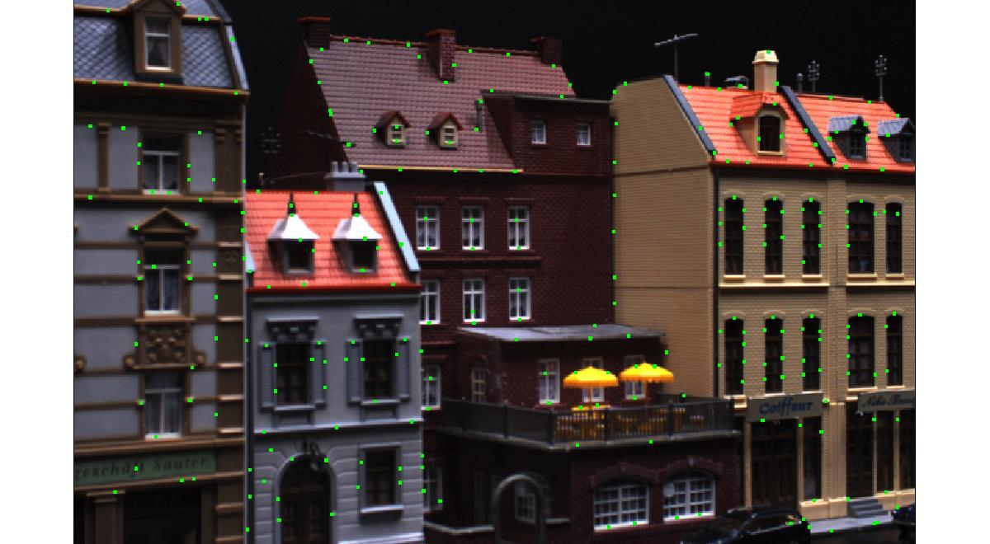
Example: Shi-Tomasi corner detection

Slide 13
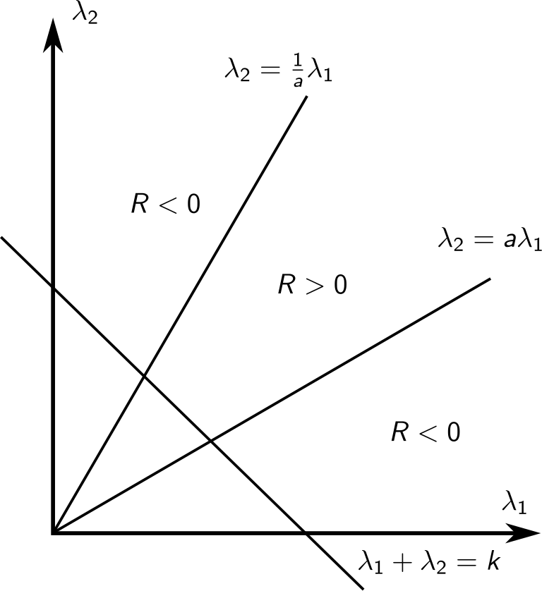
Harris corners
The Harris detector builds on the same structure tensor T. Harris and Stephens wanted to speed up and avoid the square root extraction.
We want:
Where 0 < a < 1
Corresponding to the
central area of the figure

Slide 14
A function that is positive in the central area is:
Rewrite:
with
and use that
and

Slide 15
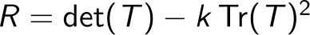
Harris detector
We get
We mark corner points as the ones with locally maximum value of R > 0.
The value of k must be < 0.25. Often values between 0.15 and 0.20 are used.
The detector may (as the other detectors) be extended to multiple scales.

Slide 16

Example Harris corner detection

Slide 17
Interest point detectors: Detecting Harris corners (fixed scale)

Slide 18
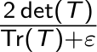
Plessey corner detector
The Plessey approach avoid the constant k using:
Where the determinant and trace is defined as before.
Corner points are marked when the measure locally is maximal.
The measure Det/Tr is found to be the harmonic mean of the two eigenvalues, i.e.:
Plessey =
Notes:
1

Slide 19

Example: Plessey corner detection

Slide 20
Many other corner/interest point detectors exist
You should be aware that you have only heard a fraction of the story.
Another detector mark points where is iso-intensity curve through the point bends locally maximal.
You may check:
The Kitchen operator
The Förstner corner detector
The Susan corner detector
Whatever you choose, be prepared to get something else compared to what you expected.

Slide 21
Now we are going to use the interest points
Consider the problem of matching two or more images
Relevant for
3D reconstruction
Content-based image retrieval
Object detection and recognition
More tasks...
In general (if we do not know a lot about from where the images are taken) a point in one image may match any point in the other image.

Slide 22
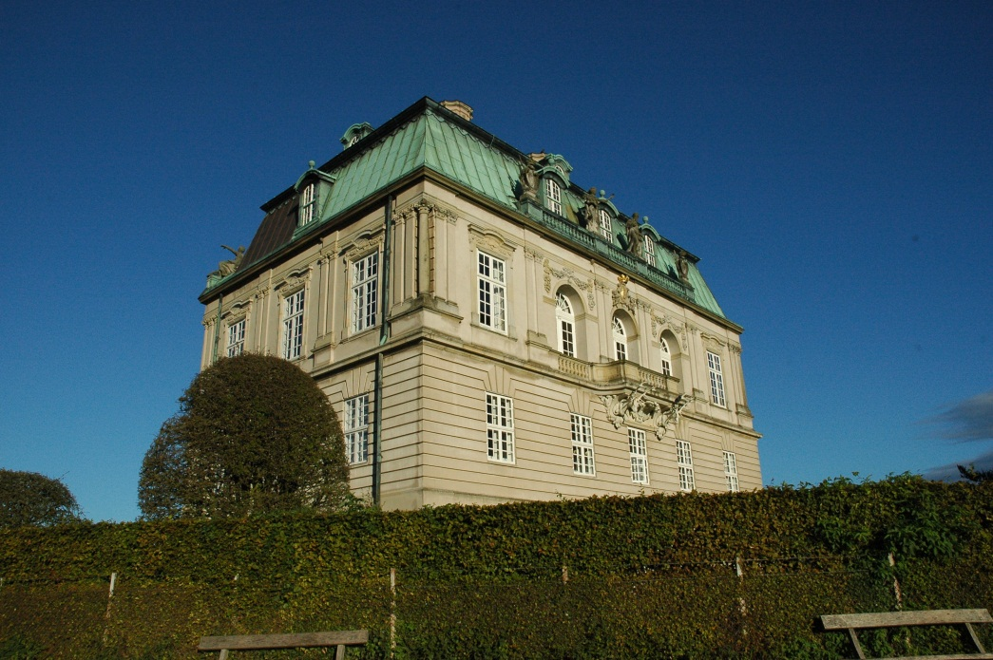
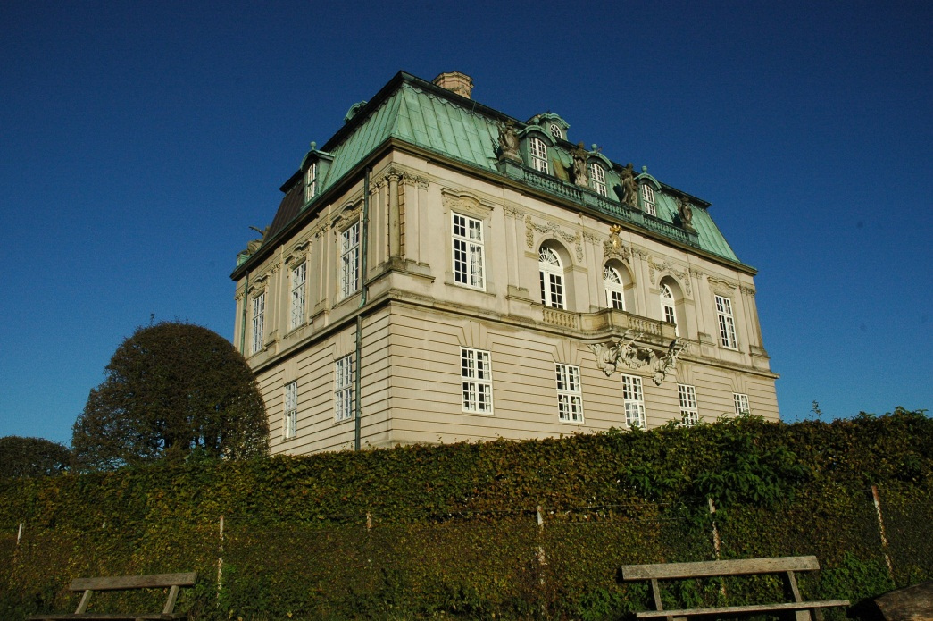
Fundamental Question: Where did the underlying feature go?
?
Matching: Ideally, we want to find the location in the other image which corresponds to the same physical location on the building
Notes:
Two different views of the same building
Ideally we would like to find the location in the other image that corresponds to the same physical location on the building.
1

Slide 23
Matching Strategy Illustrated
Notes:
Find potential matches – in principal we can have several candidates
1

Slide 24
Not all image patches can be matched
?
To be able to figure out which points belongs to which we need a bit of structure:
Sky patches are impossible to match. Occluded areas cannot be matched. Repetitive structures like windows may easily be mismatched.
Notes:
We can match distinct point structures, but curves are not trivial to match.
Make a drawing of two curves and explain the problem.
1

Slide 25
Dense versus sparse matching?
Dense : Match all pixels in the images
Sparse: Match a subset of positions in the images Both approaches have merit, but dense is computationally expensive
Notes:
Since not all locations are easily matched why not try to find good points to match?
Lets consider the sparse approach
1

Slide 26
Salient points = Interests points
Interest or Salient points: Local structure that appear distinct from the image in the surrounding region of the salient point.
We already know to detect such points!
Terminology: Salient points aka interest points aka key points aka features (old confusing terminology)
Problem: How dense do we need the points?

Slide 27
Interest point detectors: Detecting blobs
Notes:
Yellow: Dark blobs
Red: Bright blobs
Scale = 4
It also trickers on edges
1

Slide 28
How do we know the size of things?
Multi-Scale analysis
An Introduction to Scale Space Theory

Slide 29
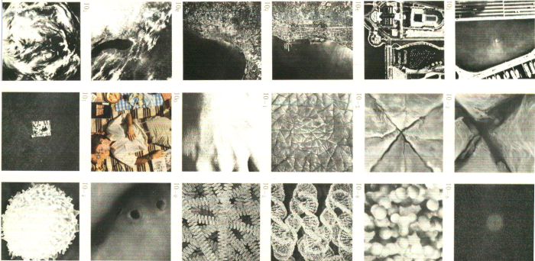
Measurements What do we measure?
Slide by Arjan Kuijper, 2003
Notes:
From outer space to atoms
1

Slide 30
Observations
Objects have a size / scale.
Objects consists of objects of various sizes.
They contain several scales.
Objects are measured by some device.
Cameras, the eye, …
Devices are finite.
They have a minimum and a maximum detection range: the inner and outer scale. They determine the spatial resolution.
The device must allow multi-scale structures.
It has to respect the various sizes of the object. The inner scale isn’t always the best scale.
Slide by Arjan Kuijper, 2003

Slide 31
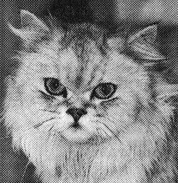

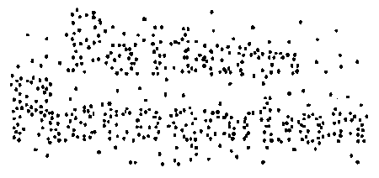
The visual system
We see multi-scale:
The images only contain two values (black and white).
We regard them as grey level images, or see structure.
Slide by Arjan Kuijper, 2003
Notes:
Dithering effect on the cats image and the text
1

Slide 32
The visual system (Founding fathers of scale space theory)
Jan J. Koenderink
Taizo Iijima
Slide by Arjan Kuijper, 2003
Notes:
Another example:
Images of Iijima have their average intensity level rescaled with the intensity of the local image patch in Koenderinks image.
We can interpret this image at fine scales and see Iijima or at large scales and see Koenderink
1

Slide 33
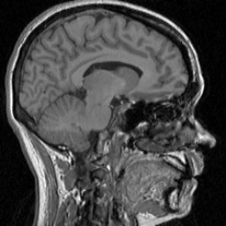



To model (II)
Don’t trust the resolution.
What does a detector of a 3 pixels circular size detect?
Slide by Arjan Kuijper, 2003
Notes:
Here we see the same object at different resolutions.
It is the same object but it appear differently.
How do we become robust to this effect?
Answer: Do processing at multiple scales to achieve scale invariance
1

Slide 34
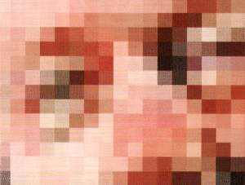
To model (III)
Don’t trust the grid.
Slide by Arjan Kuijper, 2003
Notes:
Move the object slightly in front of the camera and the image changes drastically at grid scale
<number>

Slide 35
To model a device
It has finite resolution.
Infinite resolution is impossible.
Take uncommitted observations
There is no bias, no knowledge, no memory.
We know nothing.
At least, at the first stage. Refine later on.
Allow different scales.
There’s more than just pixels .
View them simultaneously.
There is no preferred size.
Noise is part of the measurement.
Slide by Arjan Kuijper, 2003
Notes:
Next year: Consider dropping this slide
<number>

Slide 36
Deep structure
The challenge is to understand the image really on all the levels simultaneously, and not as an unrelated set of derived images at different levels of blurring.
Jan Koenderink (1984)

Slide 37
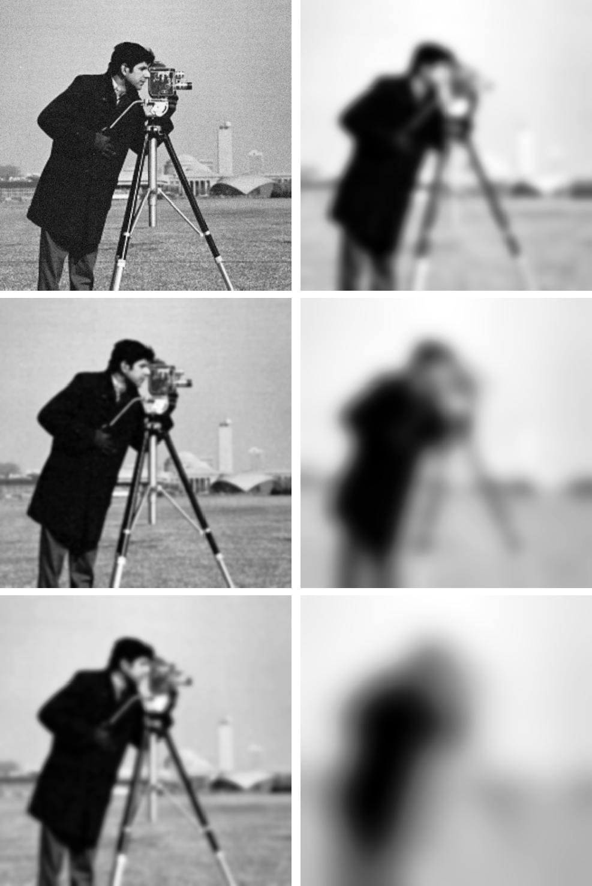
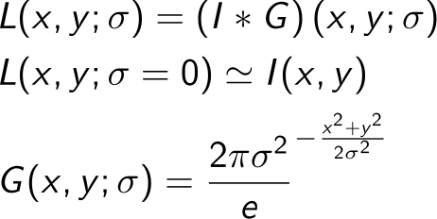
Our choice of model: Linear scale space
The scale space of I is a 1-parameter family
Scale is given by σ and is an important parameter in Computer Vision algorithms
As the scale increases details in the image disappear and we focus on the large scale structures that are left.
Notes:
At scale sigma=0 we have the original image
Next year: Try to make a 3D illustration of the scale space
<number>

Slide 38
Multi-scale versus multi-resolution: The Gaussian pyramid
Notes:
This is simply an implementation of scale space taking advantage of the reduction in detail
Next year: Consider adding a bit more details here: E.g. subsample by taking every second pixels after Gaussian blurring.
<number>

Slide 39
Multi scale analysis
There is an obvious need because we do not know the size of things.
We may have to match images obtained from different distances.
We may easily reduce resolution but we cannot increase
Multi scale analysis may be used to speed up using a coarse to fine approach

Slide 40
Coarse to fine analysis
Instead of solving the original problem reduce resolution and solve at coarse scale.
Use coarse solution to constrain the solution at finer scales.
Iterate until problem solved at full resolution.
Application within: Image matching, Flow computation/video coding, Adaptive thresholding or image normalization, Image registration etc. etc.

Slide 41
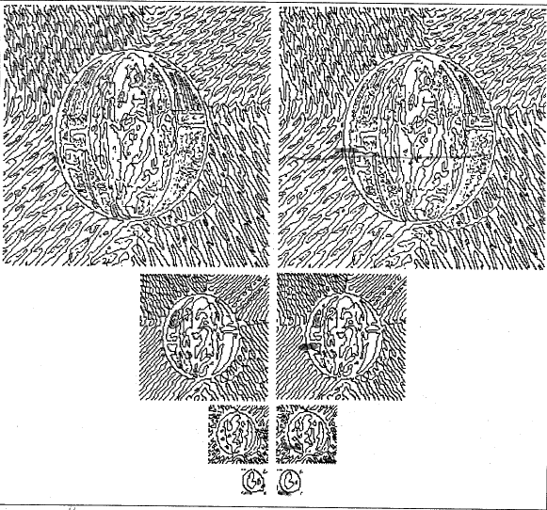
Example: Coarse-to-fine edge-based stereo analysis

Slide 42
Multi scale feature detectors
All the mentioned interest point detectors may be extended to operate on all scale levels.
Multi scale detectors must compare the detection strength at neighboring scale levels and suppress the non-maximal.
The detection strength evaluation must be scale invariant. This is a non-trivial matter (see paper by Tony Lindeberg in the supplementary material).

Slide 43
Introduction to descriptors
We have to attribute each feature point with a descriptor in order to compare if the a candidate match is good or not.
Descriptors have to be local, informative, insensitive to noise, luminance variations, perspective deformation including rotation, to pixel quantization etc.
We like compact (low dimensional) descriptors but recognize that high dimensional ones may be more discriminative.

Slide 44
Descriptors
Most modern descriptors build on
Statistics / histogramming
Spatial sampling of the gradients is some neighborhood to the interest point.
Some descriptors include color, e.g. color histograms (but we skip this here)
Few descriptors use raw image data as used in correlation
Next lecture will dwell with descriptor construction and matching

Slide 45
Literature
Reading material:
Forsyth and Ponce: Ch. 7.1 – 7.2, 7.7 (Filtering basics)
Lowe IJCV 2004, Sec. 1 – 3 (DoG, Laplacian)
Schmid, Mohr and Bauckhage IJCV 2000, Sec. 1 – 2 (Harris corner)
Lindeberg 1996 (Scale-space theory)
Additional material:
C. Harris and M. Stephens: A Combined Corner and Edge Detector. 4th Alvey Vision Conference, 147—151, 1988.
Notes:
Next year: The Lindeberg paper I think is overkill for them – convert it to additional material
<number>

